Slide 1
Goose Goose Duck Mask
Rick

Slide 2
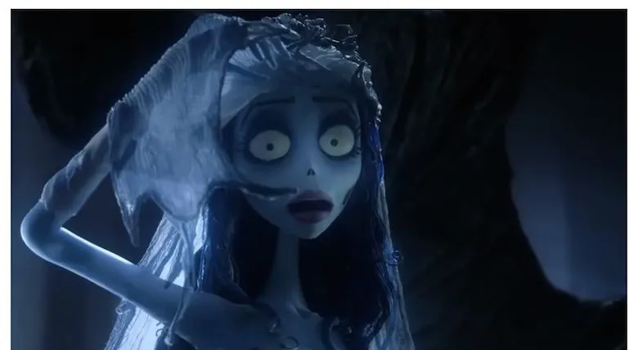
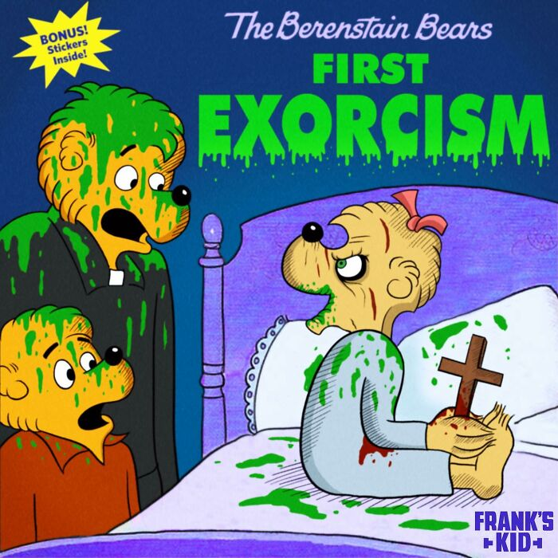
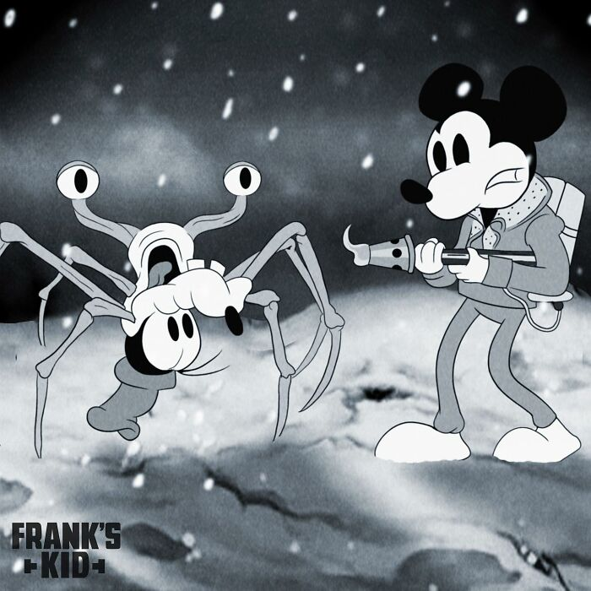
Reference
A Look Into Tim Burton’s Creative Process | by Julia Fernandez | Medium
1. Visual Style: Tim Burton Influence
Tim Burton's works have inspired me in the exaggerated proportions, dark-toned base and expressive forms in my designs. Tim Burton's characters often blend innocence with the bizarre, which aligns with the anxious yet hopeful nature of the characters I design.
Reference materials:
• https://jaf765.medium.com/a-look-into-tim-burtons-creative-process-dc36bb2cfbfb
• https://www.studiobinder.com/blog/tim-burton-style-analysis/
2. Retro Horror Cartoon
The "retro horror cartoon" style sets the tone for Kork: humorous yet unsettling. The old ink texture, poster-like aging effect, and interesting distorted elements are combined, making him both retro and horror.
Reference materials:
• https://boredpanda.com/illustration-80s-cartoons-horror-movies-crossovers-franks-kid-part-2/
• https://crimereads.com/vintage-horror-illustrations/
3. Symbolism & Character Core
The frog mask symbolizes disguise and denial, while the rabbit underneath represents vulnerability.
Childhood Cartoons Meet Horror: Artist’s Darkly Nostalgic Artwork Will Haunt Your Memories (32 Pics) | Bored Panda
Childhood Cartoons Meet Horror: Artist’s Darkly Nostalgic Artwork Will Haunt Your Memories (32 Pics) | Bored Panda

Slide 3
Background Story
Kork - a timid rabbit.
He hates his long ears and hates when others see his fear.
In the forest, rabbits are always the ones who run away,
while frogs can croak loudly, unafraid of any gaze.
One day, Kork made a frog mask.
He believed that as long as he wore it, no one would realize he was a rabbit.
He started imitating the frogs’ croaks and their jumping posture.
As time went by, no one knew his true face anymore —
even he was beginning to forget it himself.
But at night, when everything was quiet,
Kork would see his reflection in the water —
a frog mask hiding a pair of frightened, sorrowful rabbit eyes.
He kept trying to act brave,
but that mask had become his eternal cage.

Slide 4
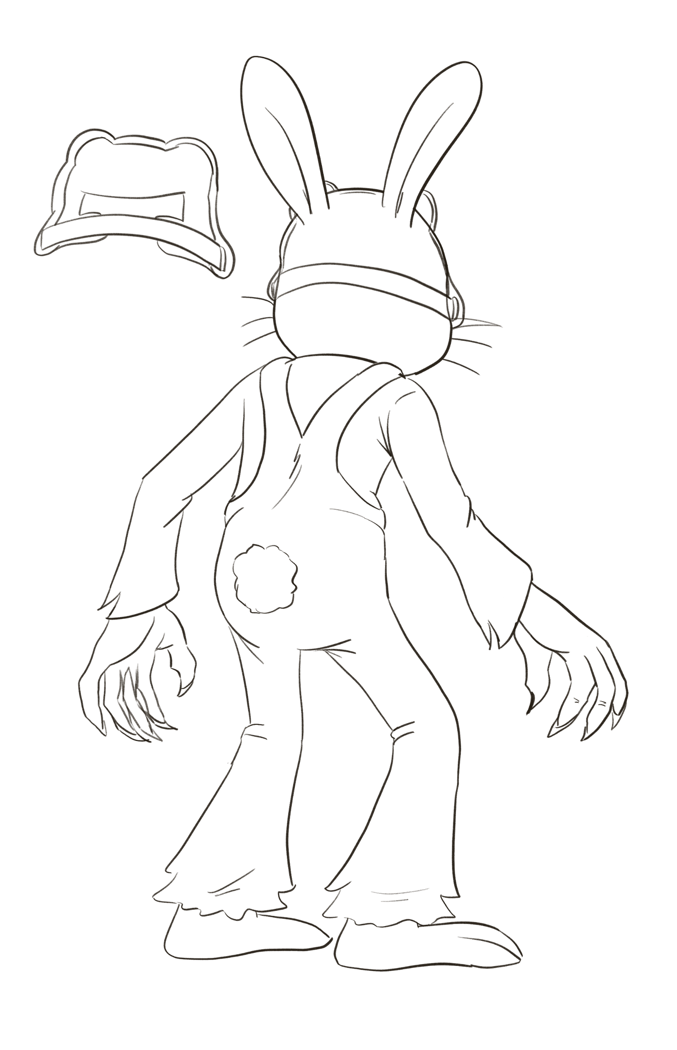
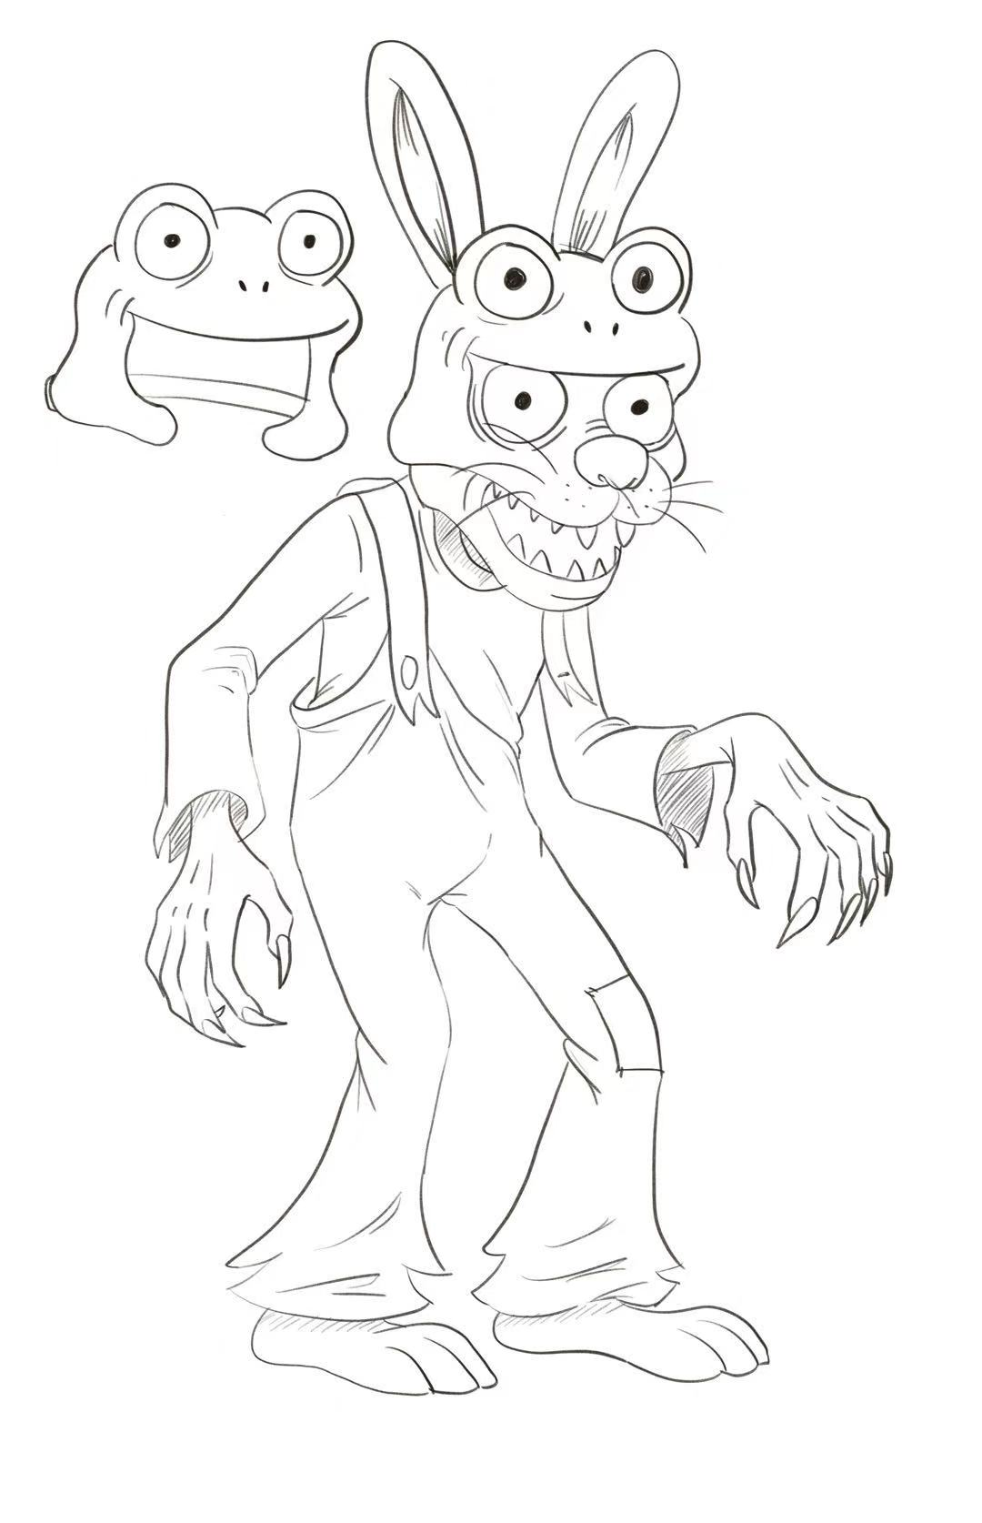
Sketch of “Kork”

Slide 5
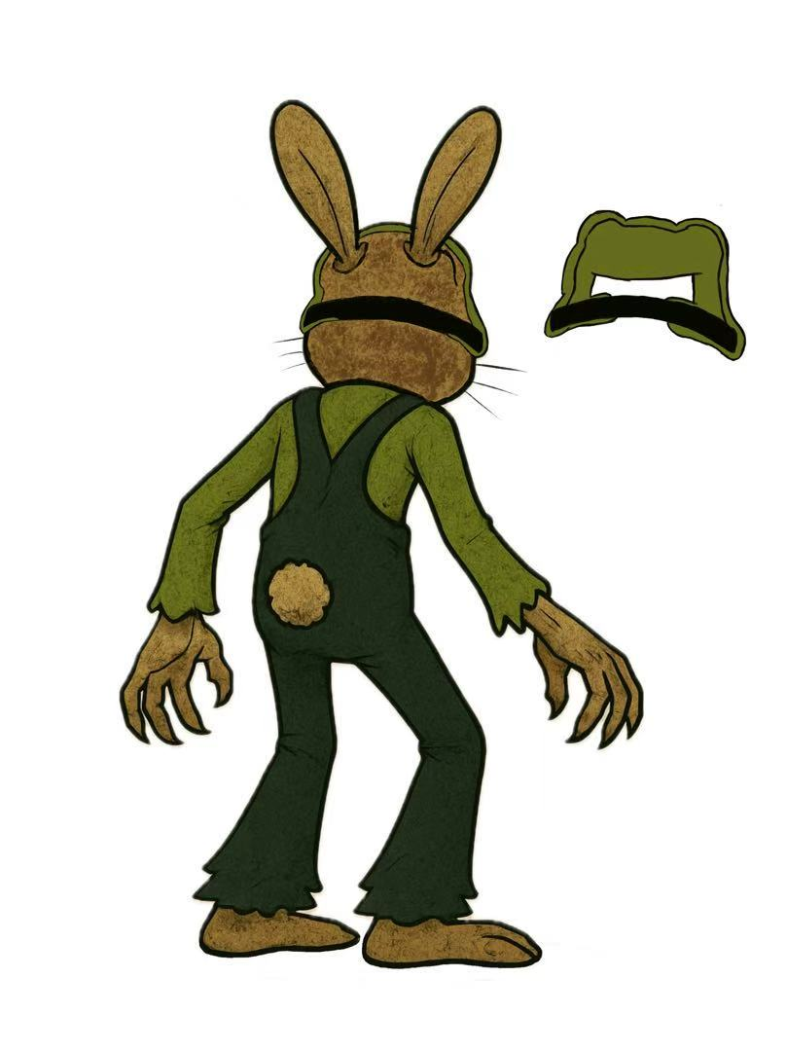
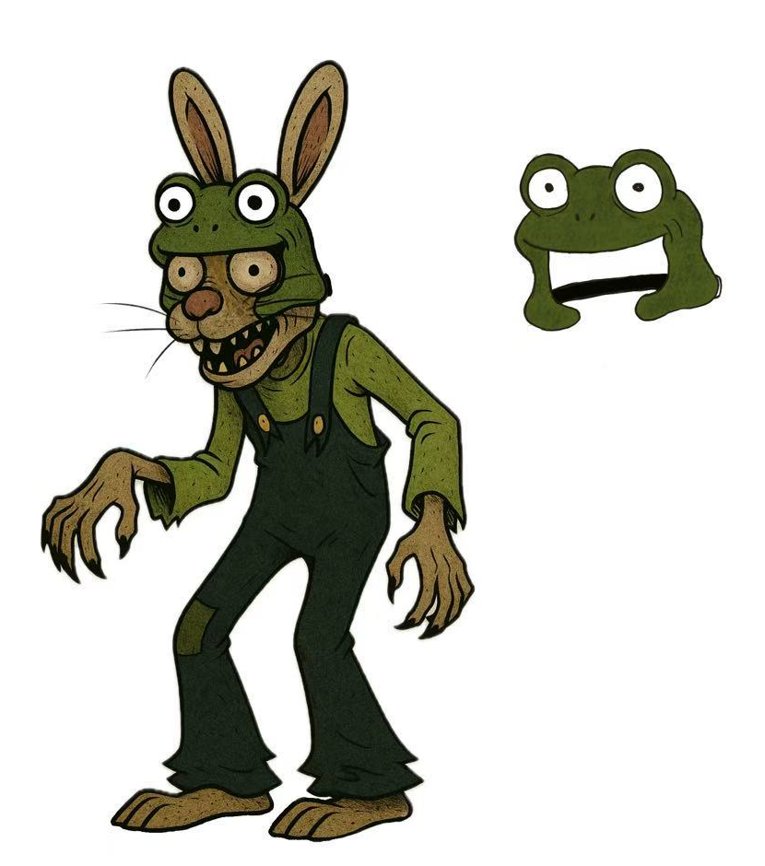
Final Product of “Kork”

